Slide 1
MANAGEMENT 312:
Negotiation and Conflict Management
Compensation Negotiation

Slide 2
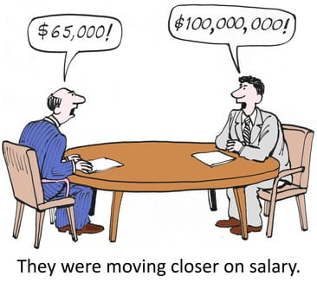
Compensation Negotiation
In many cases, an in-person compensation negotiation will be similar to today’s simulation
Remember that it is not recommended to negotiate before you have an offer
Once an organization has extended you an offer they are psychologically committed to you

Slide 3
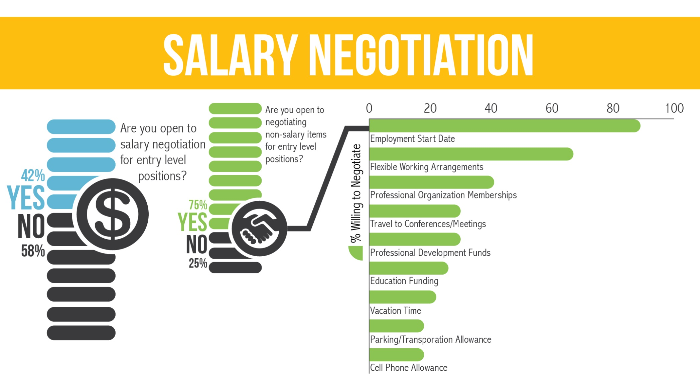
Compensation Negotiation

Slide 4
Compensation Negotiation
Most people do not negotiate the salary component of their compensation
This is particularly true of female candidates
Studies have shown that only females are much less likely to negotiation for salary, relative to other compensation benefits
Researchers believe this is a factor in the gender-based wage gap
Three primary reasons people do not negotiate
Put too low of a price on their skills
Afraid of appearing greedy
Afraid of losing an offer
Compensation negotiations are among the most difficult type of negotiation because people often tie their self-worth to how much they make
Try to separate emotion from objective and rational goals
Be prepared for your compensation negotiation
Know what you want and have a plan of how to get it

Slide 5
Compensation Negotiation Planning
Create a bargaining mix that will be used when you negotiate compensation
Where do you plan to live (be as specific as you can)?
How much do you anticipate needing to make in order to live comfortably (e.g., What will your expenses be? How much money do you want to save?)?
http://money.cnn.com/calculator/pf/cost-of-living/
What health benefits do you need?
What retirement benefits do you desire?
What additional benefits do you desire?
Plus more…
This is part of your semester project

Slide 6
No company will offer all of the listed compensation factors, but most offer several and you should seek to know what is negotiable. Across several different negotiations, I have personally negotiated for items that bold when you review this slide in a slide show.
Salary
Starting bonus
Annual bonus
Annual raise
Merit raise
Review process
Commissions
Profit sharing
Start date
Location
Health plans
Life and disability insurance
Retirement plans
Pension
Stock options
Vacation
Paid/ unpaid/ timing
Sick days
Personal days
Direct supervisor
Number of subordinates
Job assignment/ rotation
Travel
Relocation expenses
Home purchase assistance
Internal home loans
Maternity/ paternity leave
Flextime/ telecommuting
Education reimbursement
Skills training
Conferences/ professional meetings
Car allowance
Transportation reimbursement
Home office equipment
Technology/ patent rights
Spousal hire program
Childcare services
Clothing reimbursement

Slide 7
What should I do for my real negotiation?
As you should for all negotiations, plan!
Know who you will be negotiating with
Is it the final decision maker? (can they tell you yes or no?)
Determine your BATNA
If you have more than one job offer (or are considering grad school), then you have more power
Set your resistance point
Do not only base this on objective values
Seek to determine the organization's resistance point
Do your research
Ask the recruiter
Ask current employees (importance of network)
Set your aspiration point
Know what you are worth…!

Slide 8
Salary Comparison Websites
Indeed.com
Glassdoor.com
Salary.com
Payscale.com
Levels.fyi
h1bdata.info
Talk to as many people as possible
Learn what others have received
Use the career center and contacts with recent graduates

Slide 9
What should I do for my real negotiation?
Know what you want
Salary is only part of the package
Vacation, flexible location/hybrid, promotion process, laptop, etc.
Know what the company needs and wants
Demonstrate how you are exactly what they need
What other skills do you have that are beneficial
e.g., multilingual, cross cultural experience, other work experience, network connections, can build a website…etc.
Logroll
More issues than just salary
Some companies have less flexibility with salary
Value may differ on the issues
Learn what you can trade

Slide 10
When the Organization Makes an Offer
Expect an offer that is lower than their best offer
Most companies expect you to negotiate
When you receive an offer via email, respond promptly, thank the company, tell them you will review it right away and then wait at least one day before setting a time to discuss
This shows that you carefully considered and researched the offer
First, always reaffirm that you want to work for the organization
Try to discuss the offer in person (non-verbal cues)
If not, try video, or, if you must, the phone
If they tell you “an increase would affect our salary structure,” seek to answer:
What is the structure?
Where do I fall in it?
How do I move up the next salary band?
Does it require a position or title change?
Gather information for future negotiations (long-term perspective)

Slide 11
What if they ask how much I want?
Companies often ask with the hope that you undervalue yourself
Clarify whether they are making you an offer, or gathering information
If offering the job, then state your request (be prepared)
Be aggressive, but have justification for why you state a value – plan!
Because of X, Y, and Z, I think $ is appropriate
If gathering information:
Delay – tell them you would like to know more about the job and your role in the organization
Request industry average
Ask them to define industry average once they offer the job
If you are forced to give a range, make it tight
Low end within their range, but high can be beyond
Be ready to justify your worth
Tell them salary is important, but there are other benefits you care about as well

Slide 12
What should I not do?
What bothers recruiters?
Candidates who focus exclusively on the base salary and not other benefits of the full package
Trying to start a bidding war between two companies
Shows that you are more concerned about money than about a relationship with the company
If you ask for more and they give it, you should be prepared to accept the job (burnt bridges)
Not basing your demands on relevant facts
My friend makes more money at…

Slide 13
What your Recruiter/HM thinks about during the offer process
Balancing your offer w/ internal equity
Easier to adjust stock and sign-on
What happens if there are significant equity gaps?
Intrinsic vs Extrinsic values of candidate
Validates throughout process
Value of the role
Niche vs broad skillset required
Market competition
Total compensation vs just base
Competitive intelligence
Ensuring they know your Yes in a counter offer
Pre-closing, future pacing, commitment bias

